Slide 1
Cultural Collage
Who am I?

Slide 2
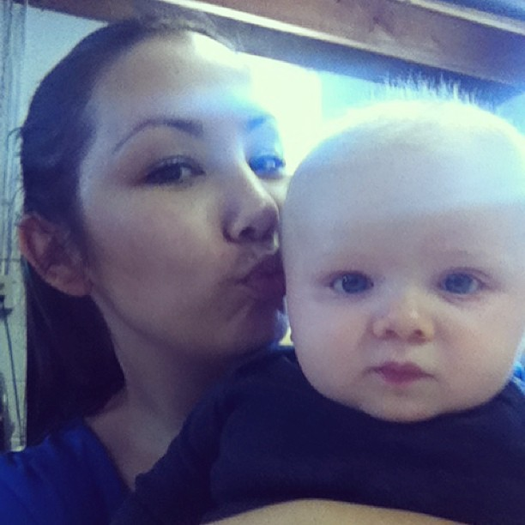
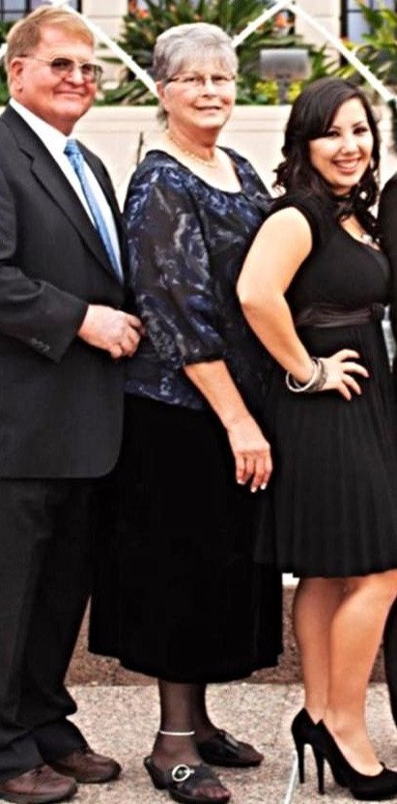
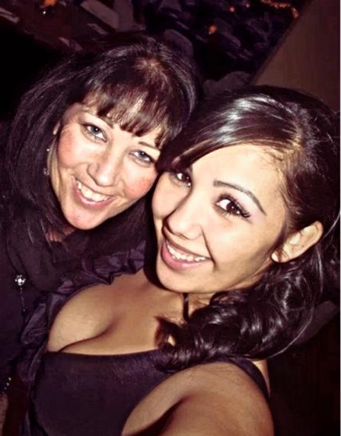
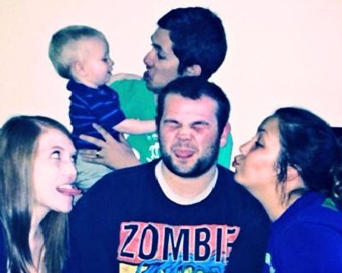
Family roles
I have the best family in the world and the roles I have within it have definitely shaped who I am and how I view the world.
Granddaughter
Daughter
Aunt
Twin
Sister

Slide 3
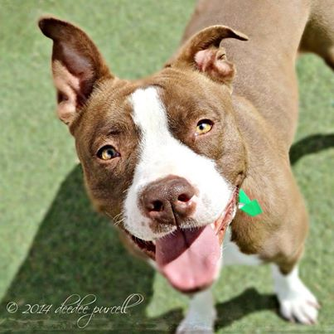
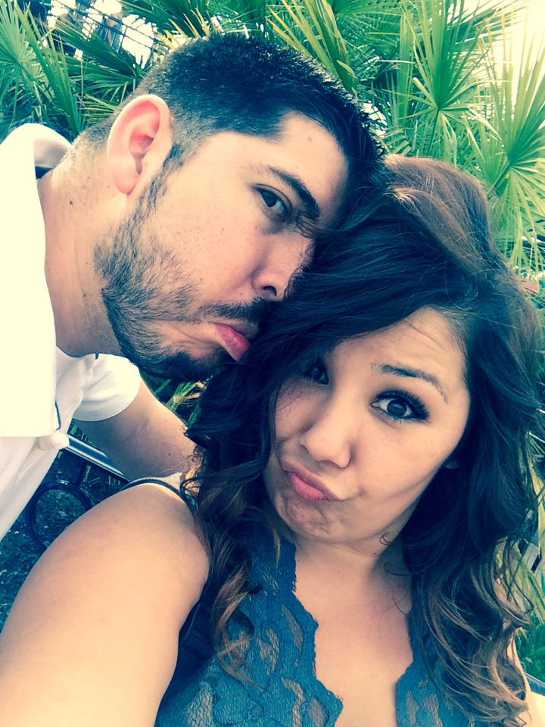

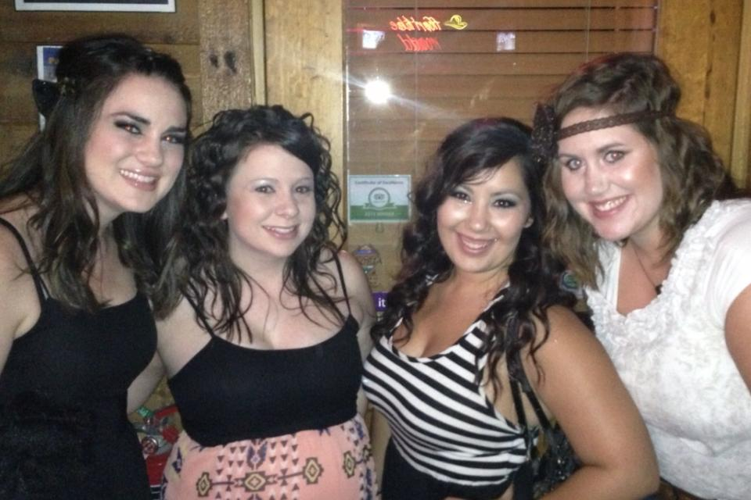
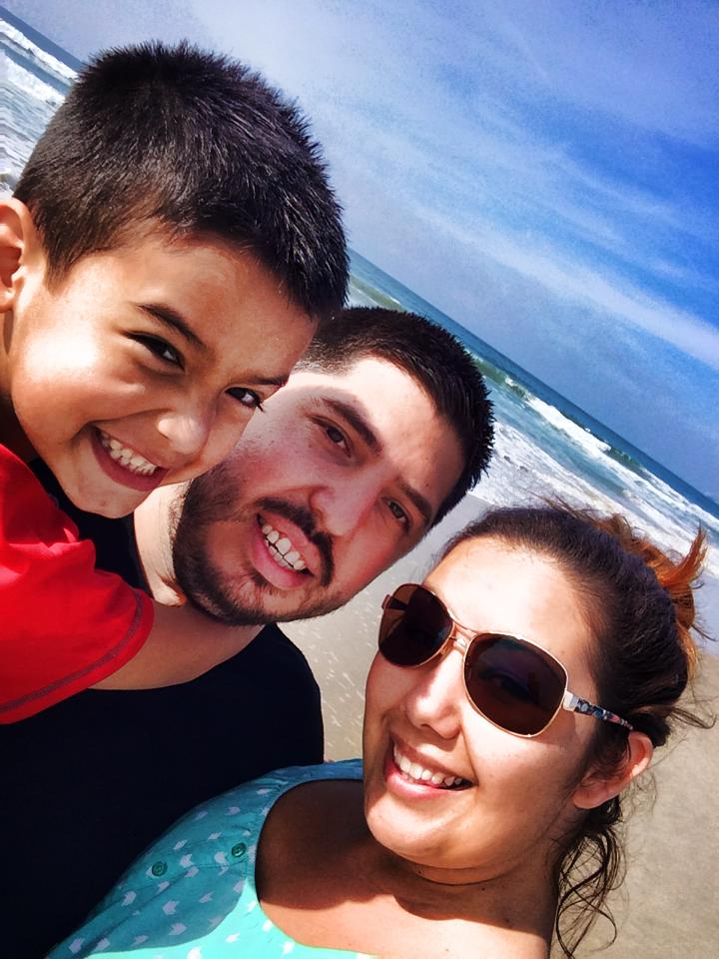
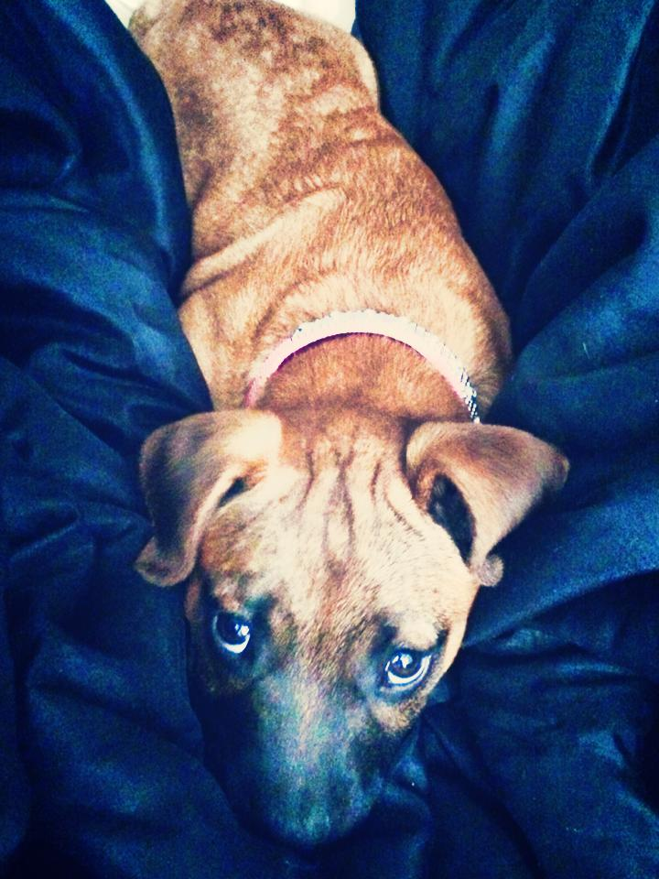
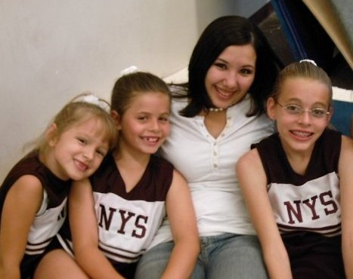
Other roles
Many other roles
that I play in my life directly represent my culture and values:
Fiancé
Stepmom
Friend
Dog Rescuer
Cheer Coach
Student

Slide 4
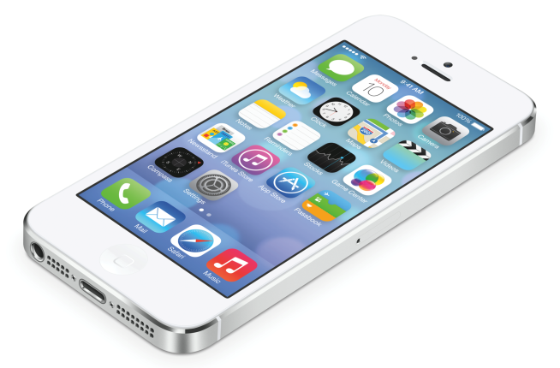



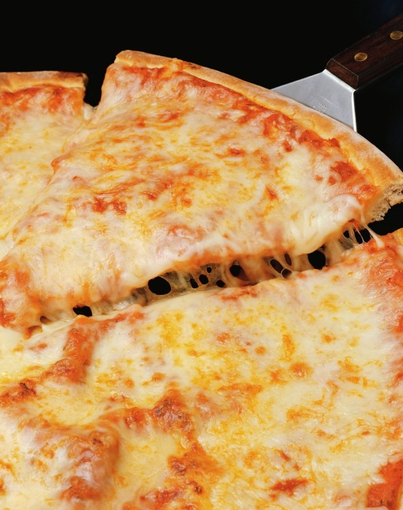
Demographics
My personal demographics set me apart from anyone else. Growing up as an American, middle-class, millennial female, the behaviors I learned from the culture I was surrounded by include competitive, technology savvy, slightly feminist, independent, impatient, ambitious, open-minded, free-spirited, multi-tasking, etc.

Slide 5

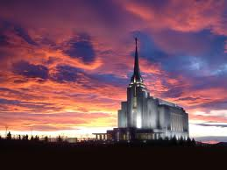
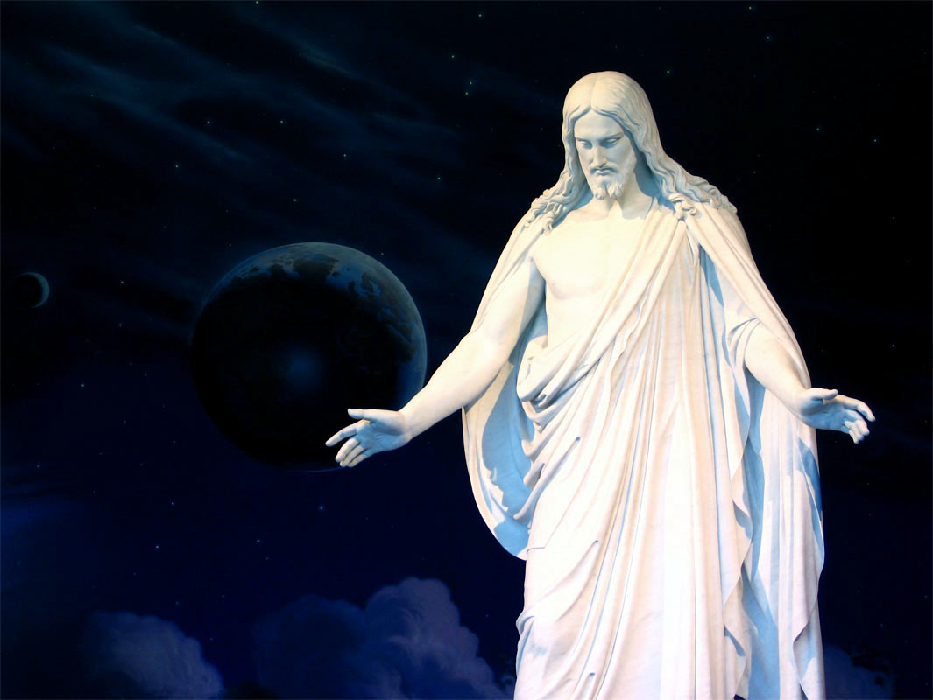
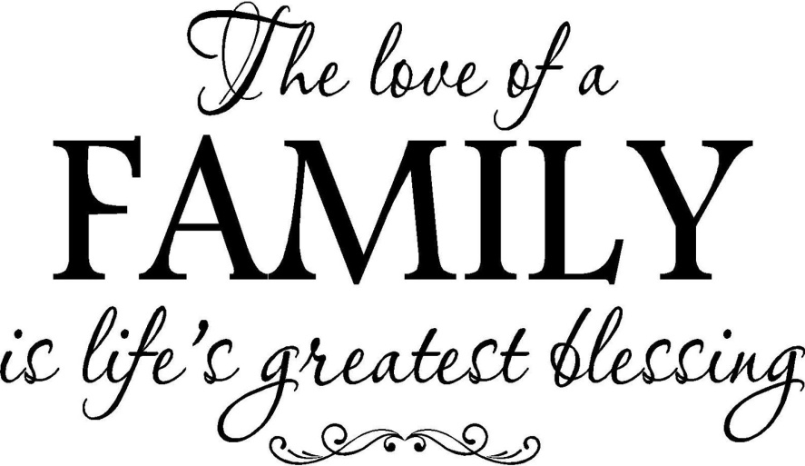
Values
I was raised with solid moral and ethical values. I was taught and strive daily to live the golden rule: do unto others as you would have them do unto you. I believe in God and my religion. While I don’t often get into political discussion, I consider myself part of the Republican party. My family is truly the greatest blessing in my life.

Slide 6
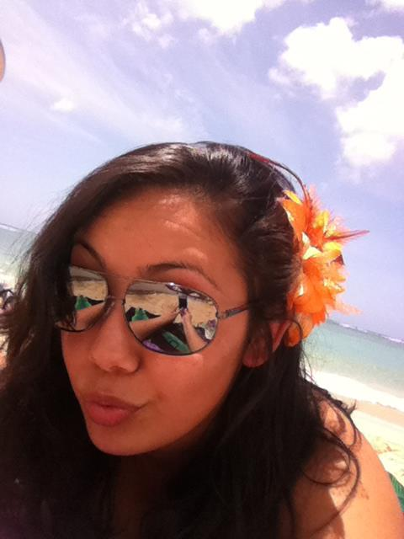
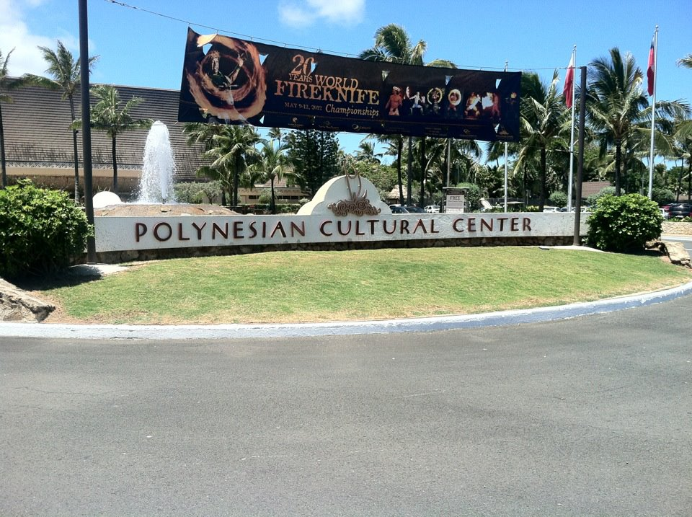
Ethnic Identity
Most of my life I’ve struggled to find an ethnic identity. My mother is adopted so we don’t know much about her heritage and I’ve never met my biological father. I know that he was of Polynesian descent and that he and my mom met in Hawaii. She was attending the University and he worked at the Polynesian Cultural Center. I have closely studied Hawaii and the Polynesian Islands to grow closer to my ethnic origins.

Slide 7
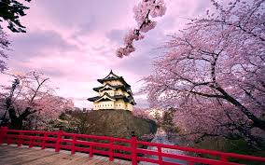
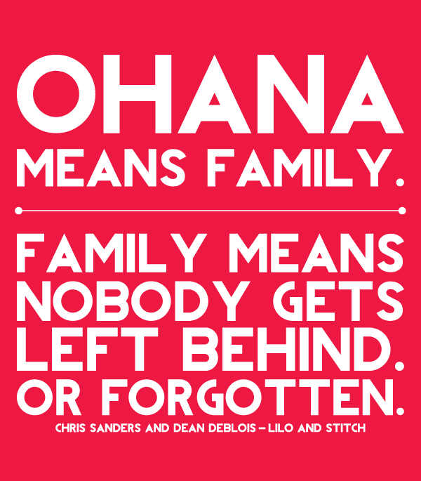
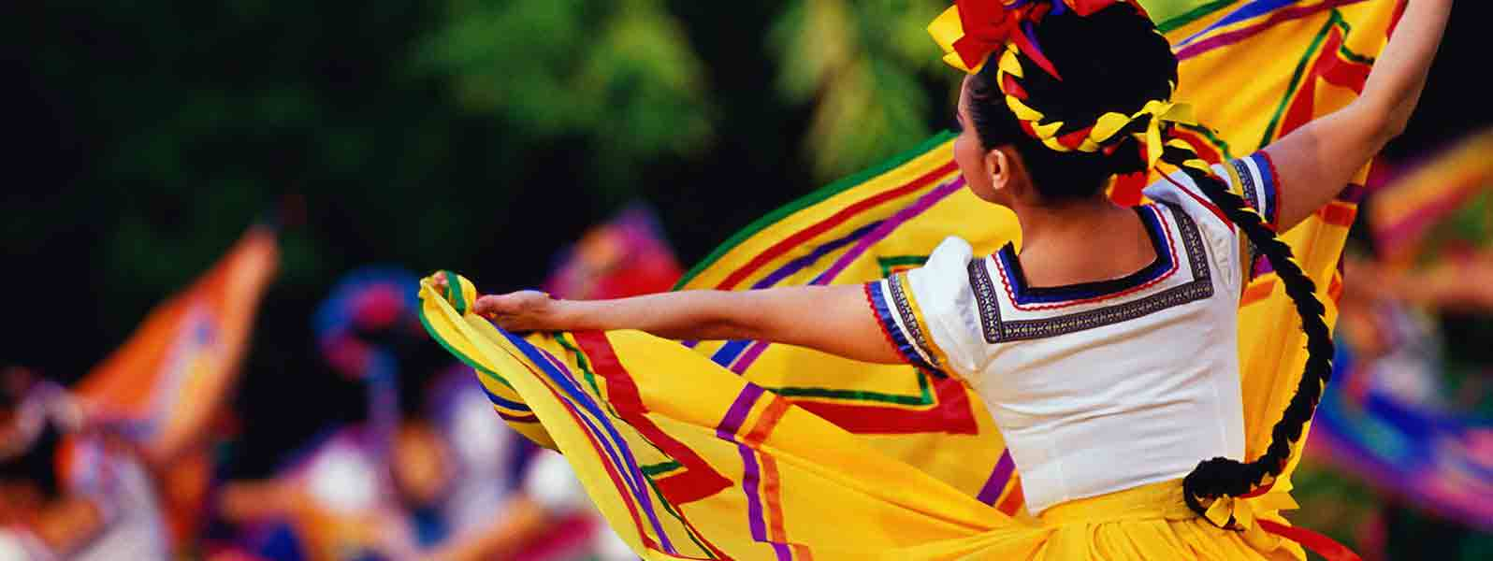
Cultural Experiences
I love to travel and in doing so have experienced several different aspects of various cultures. From the “Ohana” of Hawaii that extends so much further then the traditional American family, to the quiet, peaceful meditation of Japanese gardens that especially contrasts with the American fast-paced way of life. In Mexico, the music, dancing, and traditions that are customary for respecting the deceased are very unlike anything in American culture.

